Slide 1

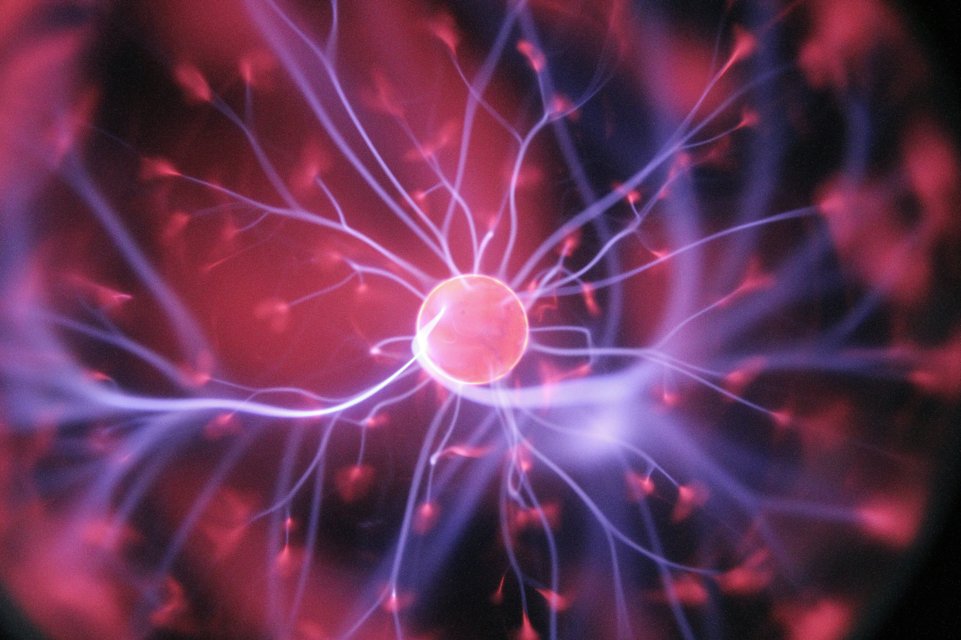
MULTIPLE SCLEROSIS DETECTION USING DEEP LEARNING
- Samikshya Adhikari
Advisor : Dr. Kazim Sekeroglu

Slide 2
Introduction
Literature Review
Data Pre-processing
Models
Result and Discussion
Conclusion

Slide 3
Introduction
Literature Review
Data Pre-processing
Models
Result and Discussion
Conclusion

Slide 4
Introduction
Literature Review
Data Pre-processing
Models
Result and Discussion
Conclusion

Slide 5
Introduction
Literature Review
Data Pre-processing
Models
Result and Discussion
Conclusion

Slide 6
Introduction
Literature Review
Data Pre-processing
Models
Result and Discussion
Conclusion

Slide 7
Introduction
Literature Review
Data Pre-processing
Models
Result and Discussion
Conclusion

Slide 8
Introduction
Literature Review
Data Pre-processing
Models
Result and Discussion
Conclusion

Slide 9
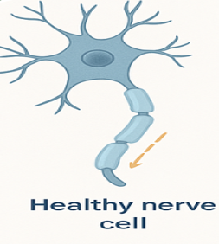
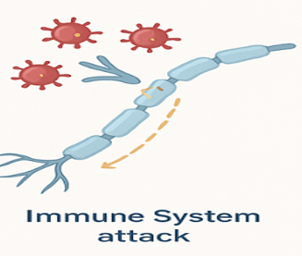
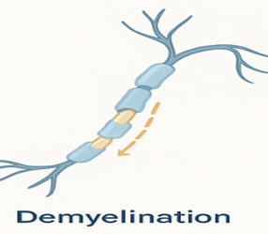
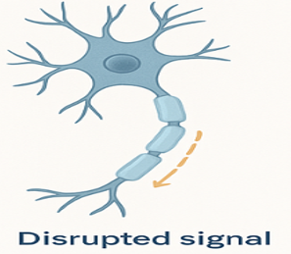
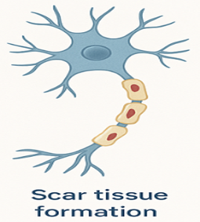

What is Multiple Sclerosis?

Slide 10
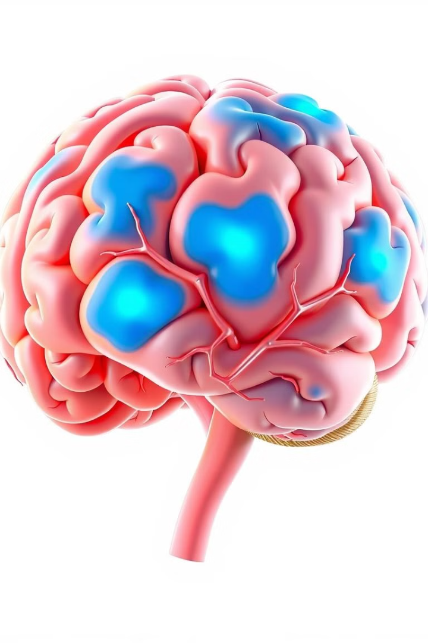
INTRODUCTION
Problem Definition
Unpredictibility and Variability
Chronic and Progressive Nature
Diagnosis and Treatment challenges
Limited public awareness
Relapsing and Remitting Course

Slide 11
INTRODUCTION
Motivation
Enable early detection of MS
Overcome limitations of slice-based approach
Analyze role of each architectural model
Evaluate performance on slice vs patch data
Lays groundwork for lesion localization

Slide 12
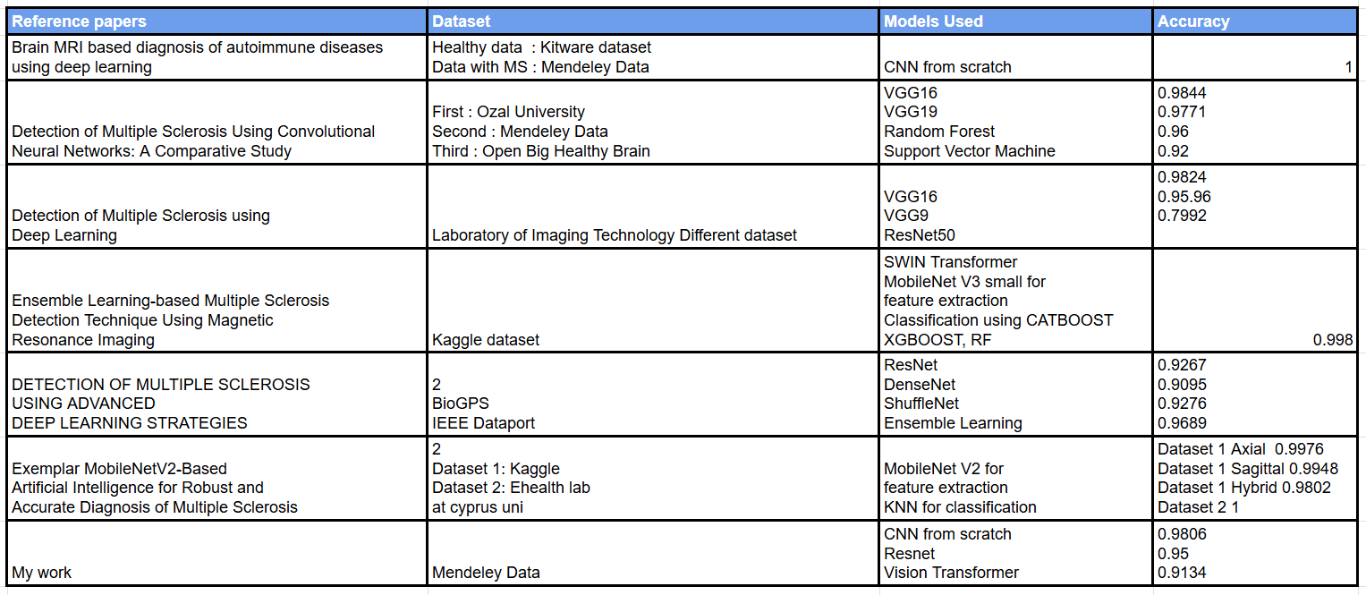
LITERATURE REVIEW

Slide 13
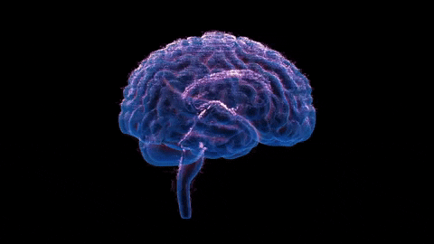


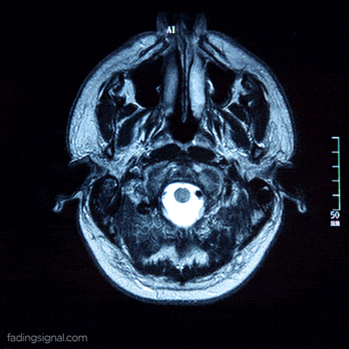

Data Pre-processing
Conversion of 3D images into 2D slices of images
Data Collection
Publicly available data containing 60 patients collected from
Baghdad Teaching Hospital, Iraq
Visualization
MRI slices are visualized in axial, coronal, and sagittal planes
to understand lesion positions in 3D.
Nibabel
The Nibabel library is used to handle NIfTI files (3D),
a common format for medical images.

Slide 14

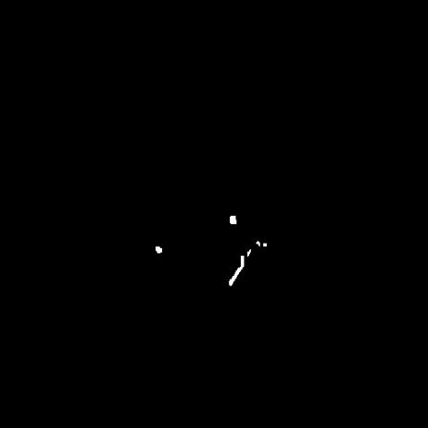
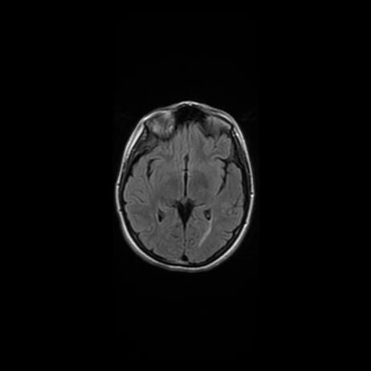
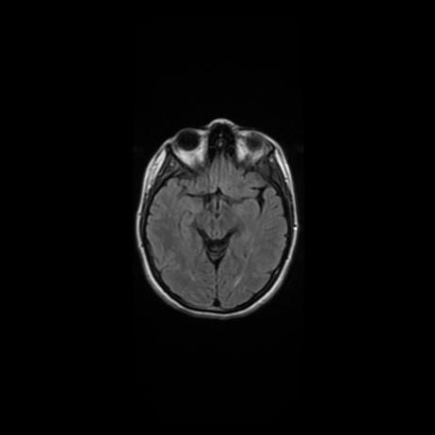

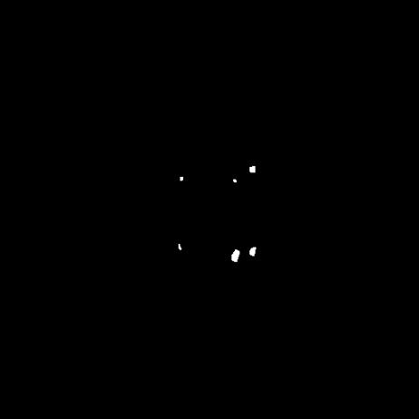
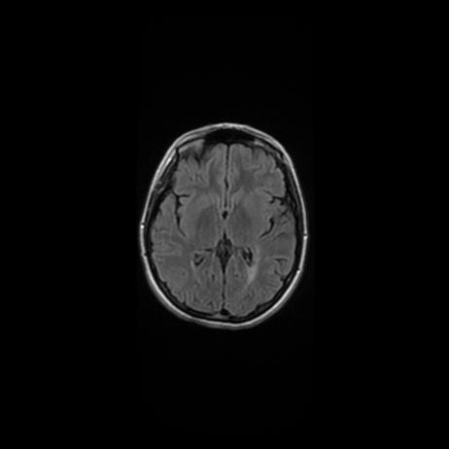
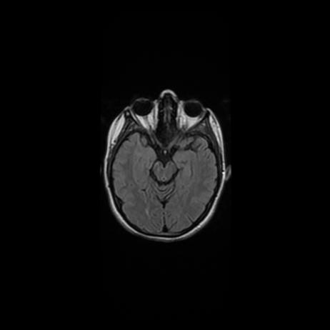
Data Pre-processing

Slide 15
Data Pre-processing

Slide 16
Data Pre-processing

Slide 17
Data Pre-processing

Slide 18
Data Pre-processing
Largest lesion analysis
Creation of sliding window
Patch extraction

Slide 19
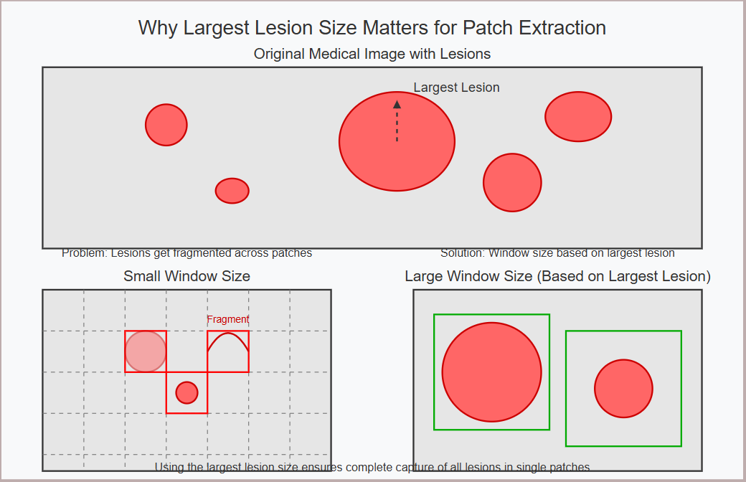
Data Pre-processing​

Slide 20
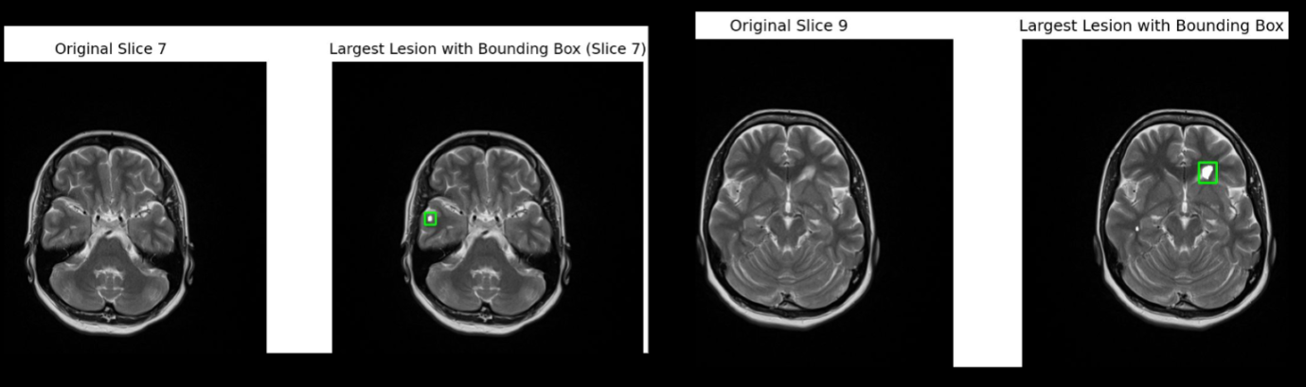

Data Pre-processing
Largest Lesion Analysis
The largest lesion is of size 146 * 81 :

Slide 21
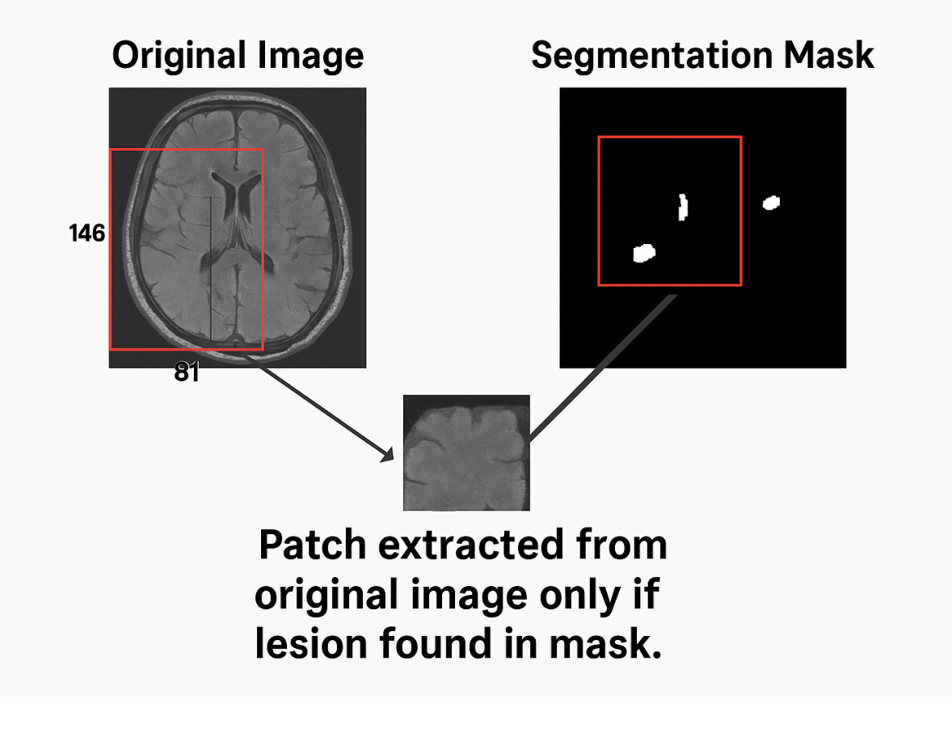
Data Pre-processing
Creation of sliding window

Slide 22
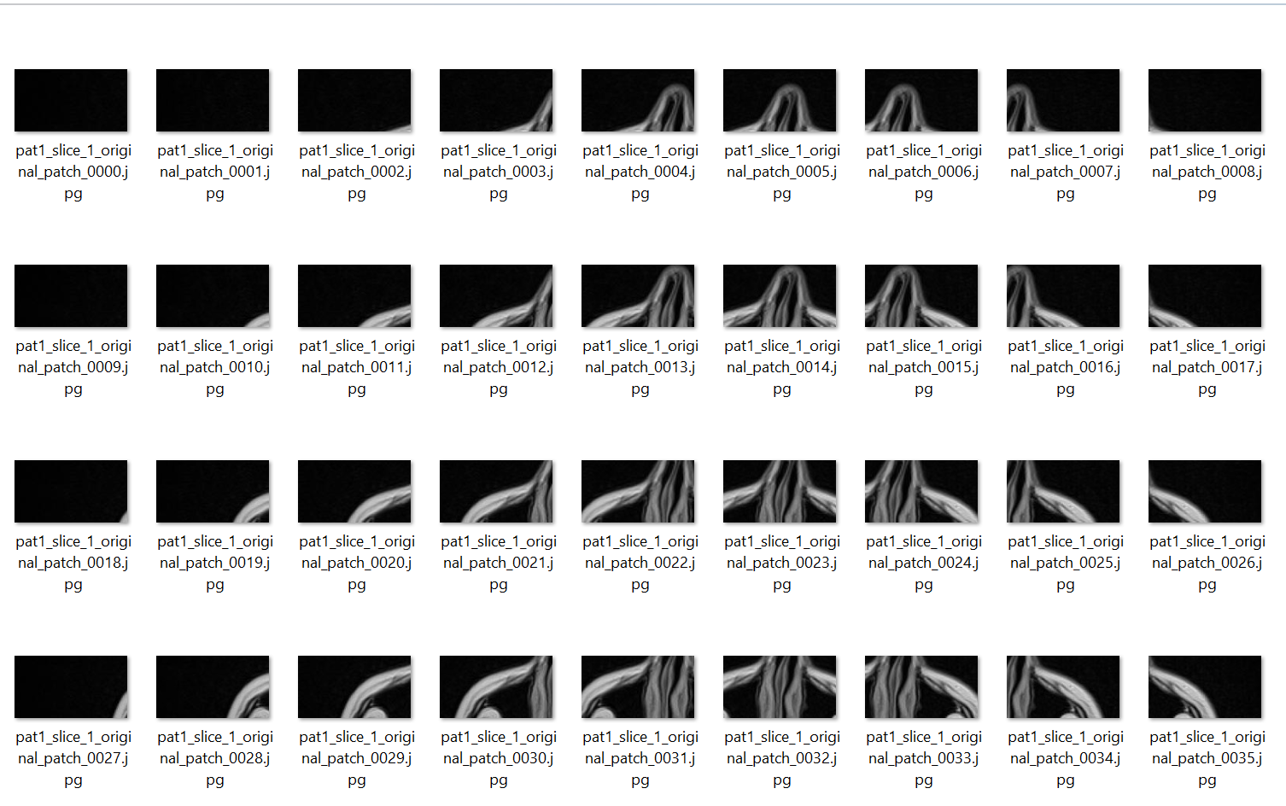

Data Pre-processing
Patch extraction
0 – 205545 Patches
1 – 42953 Patches
Total – 248498 Patches

Slide 23
Methodology
Models
Resnet
CNN
ViT

Slide 24
Methodology
Models used
Models
CNN
Resnet
ViT

Slide 25
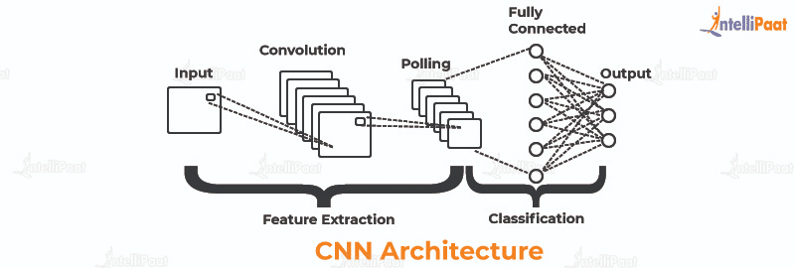
Models​
Convolutional Neural Network
Extracts local patterns using filters
Detects edges, shapes, and textures
Works hierarchically from simple to complex features
Uses pooling to reduce dimensions
Efficient for image classification tasks

Slide 26
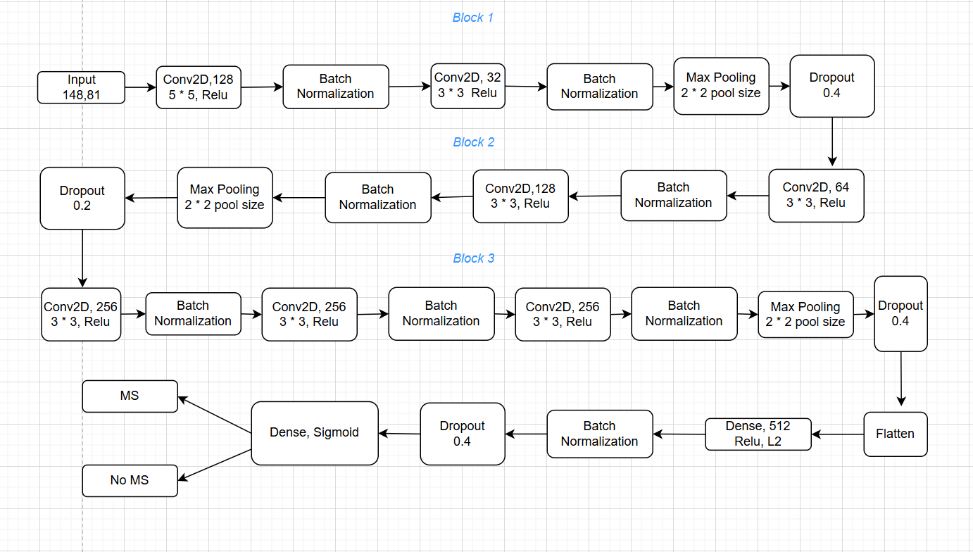
Models
CNN block diagram

Slide 27
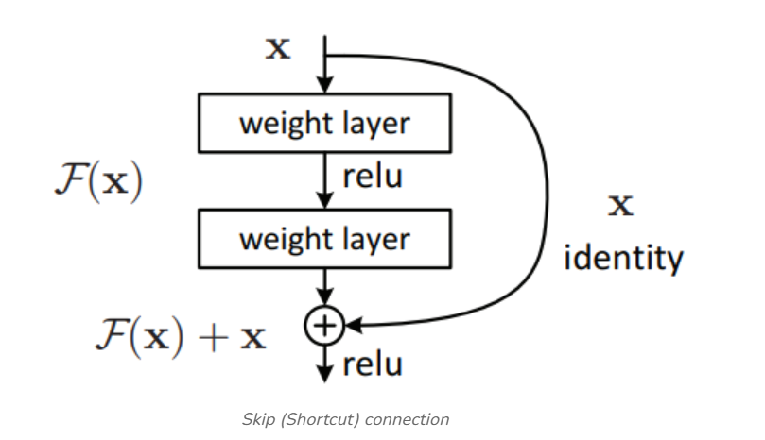
Models​​
Resnet
Enables very deep networks
Uses skip connections to avoid vanishing gradients
Learns residuals instead of full mappings
Improves training stability and accuracy
Captures deeper, more complex features

Slide 28
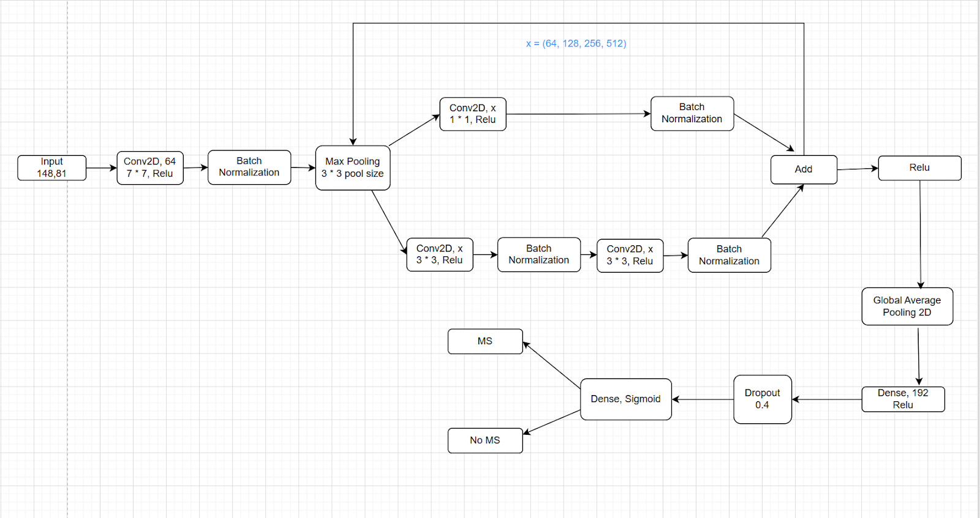
Models
Resnet block diagram
Skip connection

Slide 29
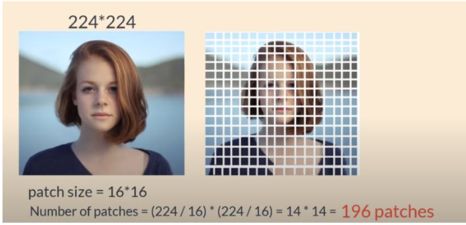
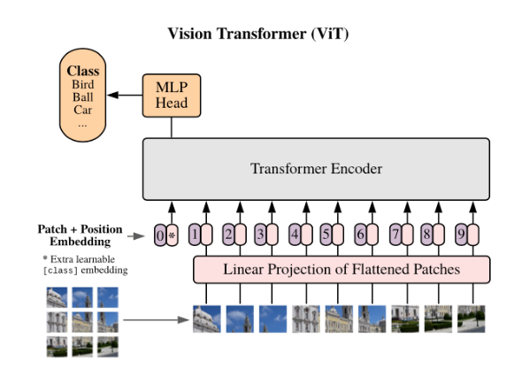
Models​
Vision Transformer
How ViT works?
Images to Patches
Flattened
Patch Embedding
Positional Embedding
Feed into Transformer Encoder
Classification Head

Slide 30
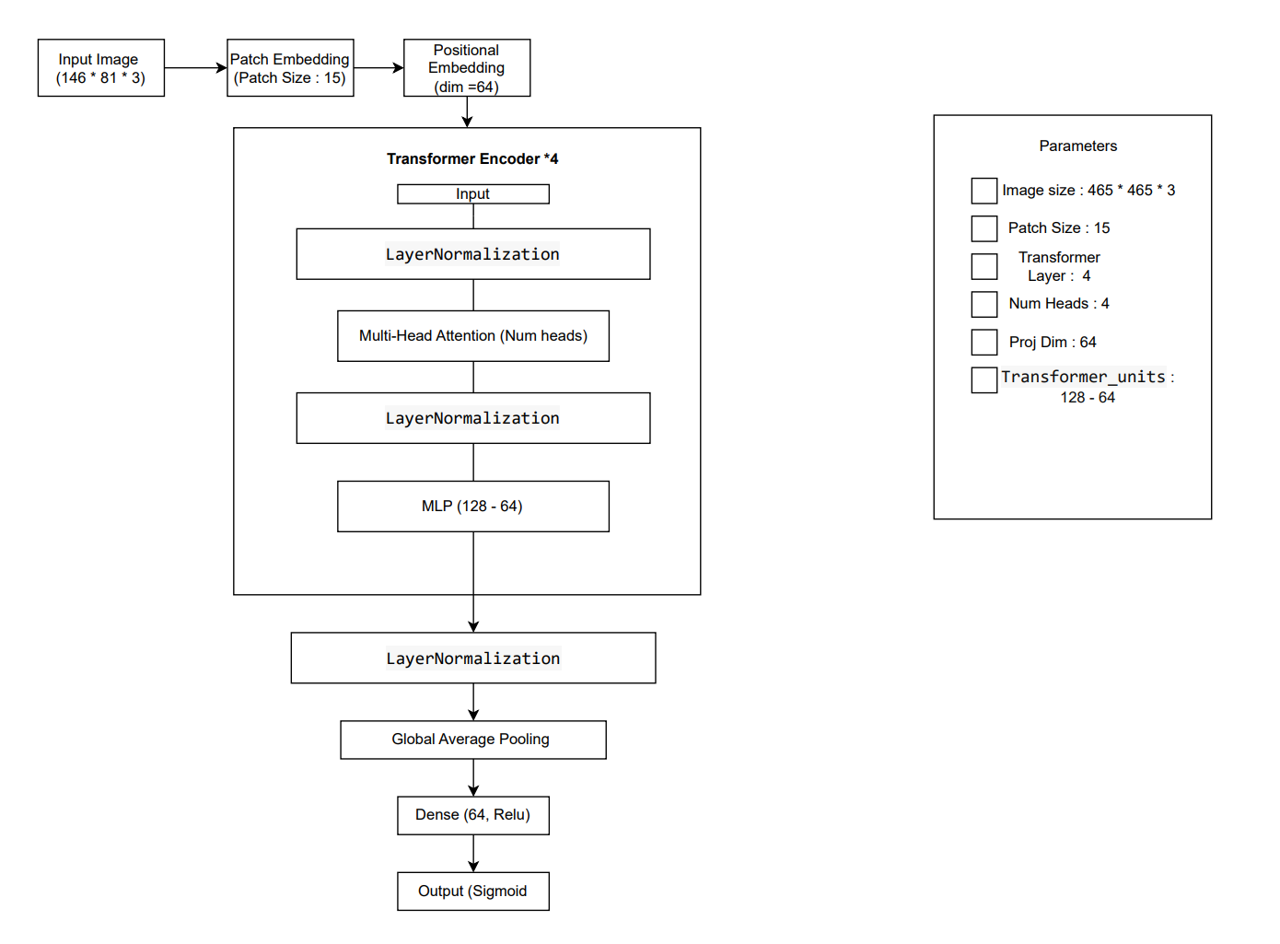
Models
Vision transformer block diagram

Slide 31
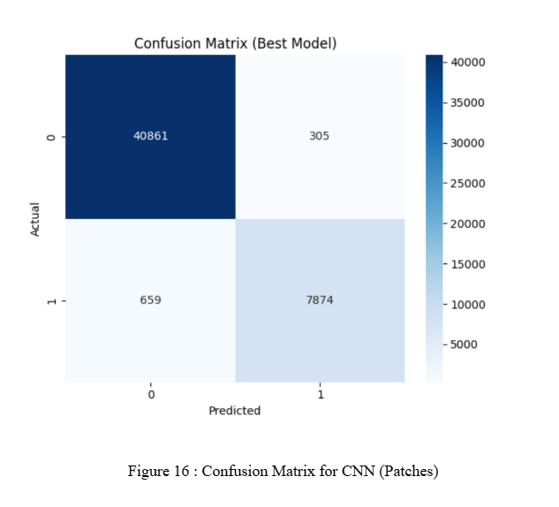
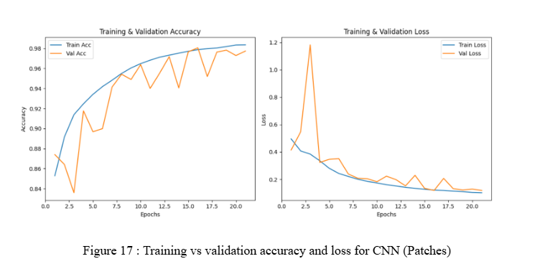
Results and discussion
CNN Results

Slide 32
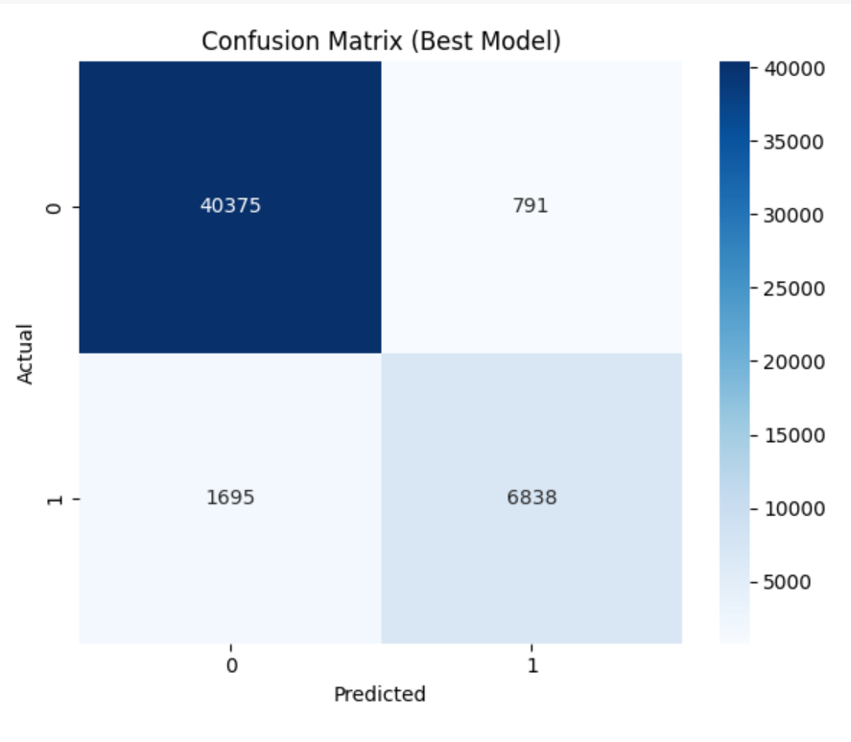
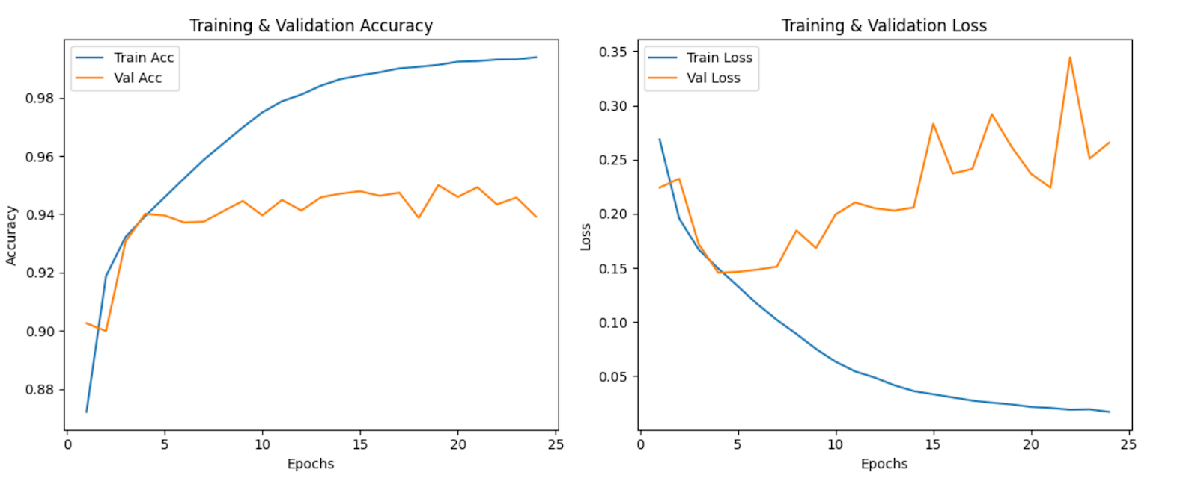
Results and discussion
Resnet Results

Slide 33
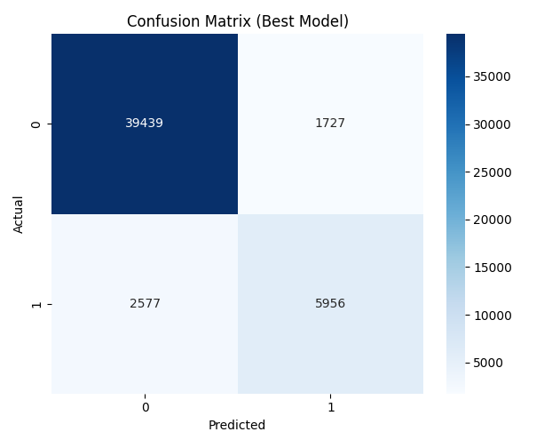
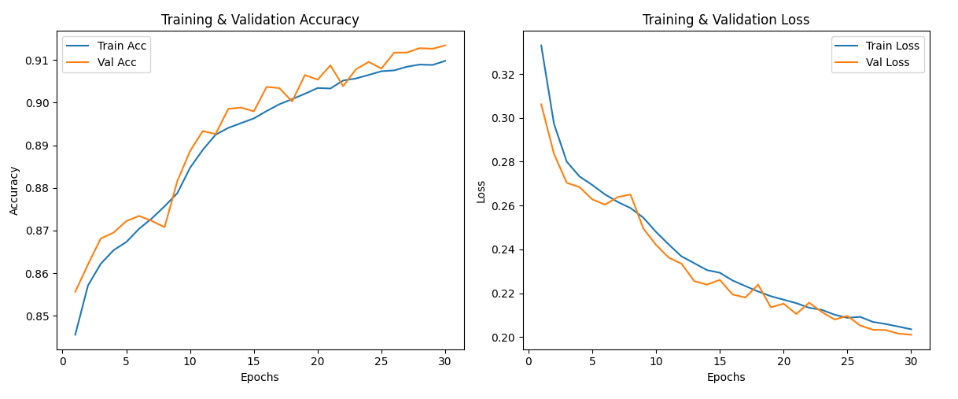
Results and discussion
ViT Results

Slide 34
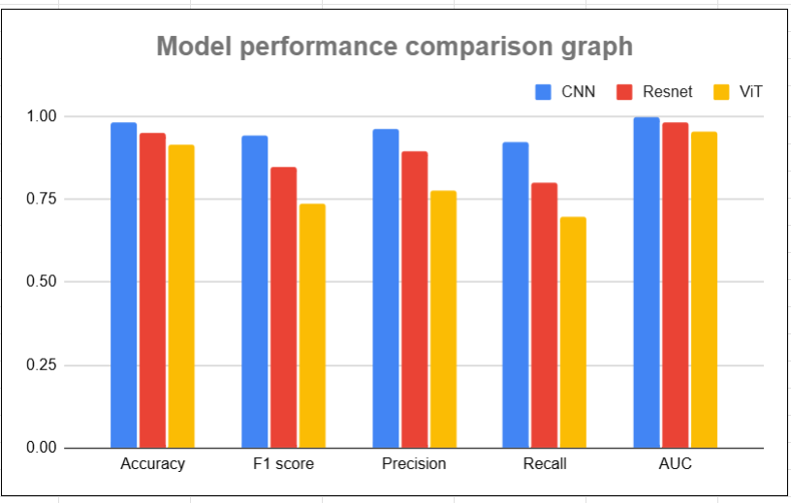
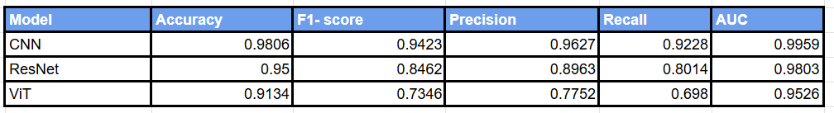
Results and discussion
Model performance for patch based images

Slide 35
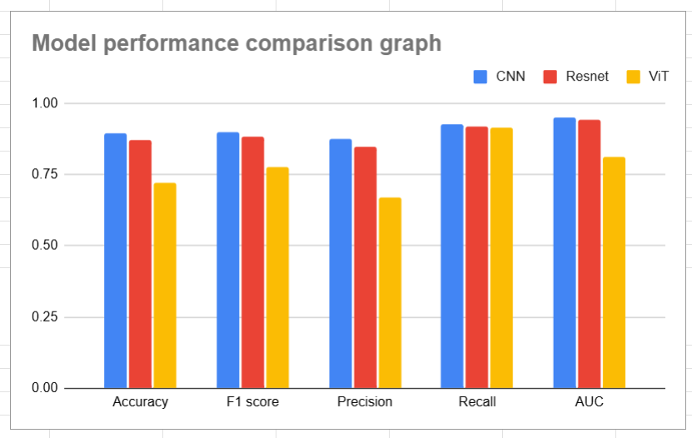
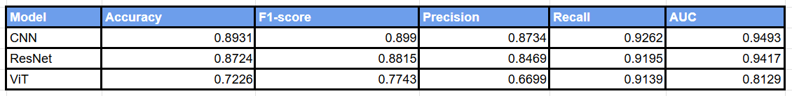
Results and discussion
Model performance for slice based images

Slide 36
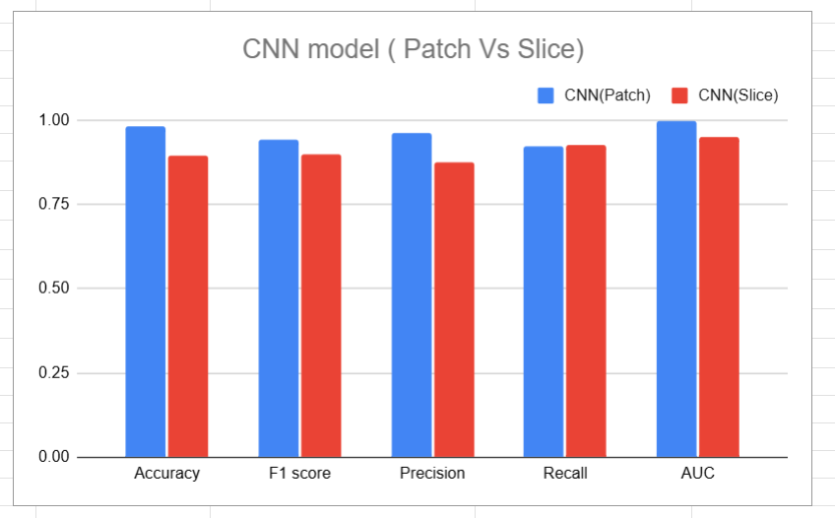
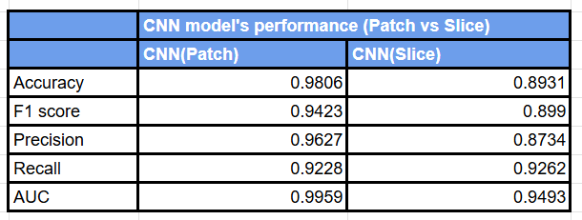
Results and discussion

Slide 37
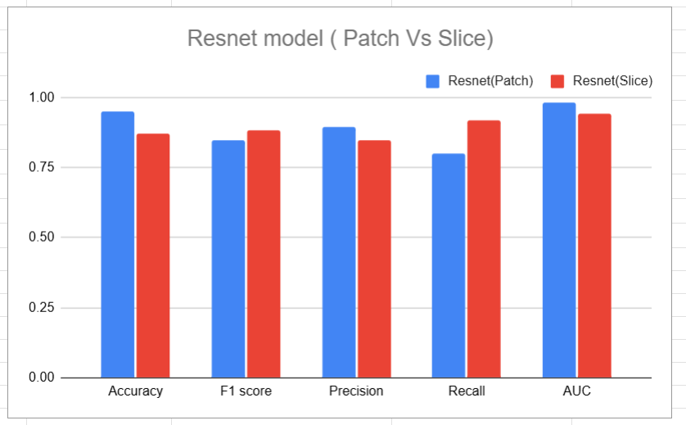
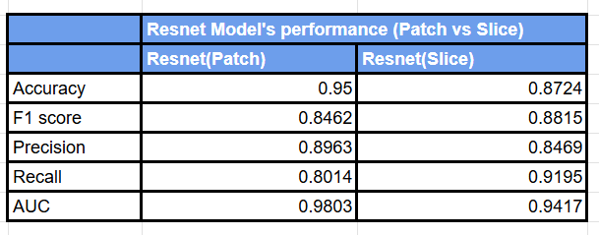
Results and discussion

Slide 38
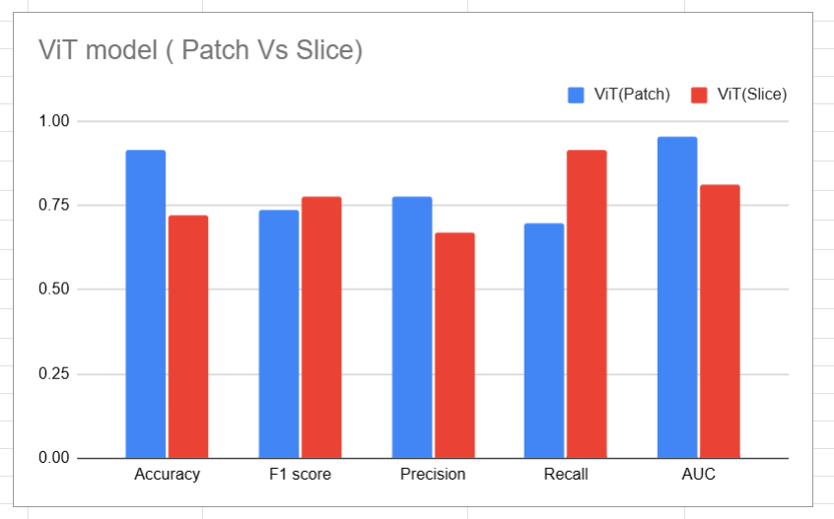
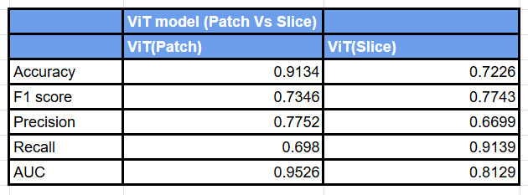
Results and discussion

Slide 39
Conclusion and Future work
Compared three model architectures: convolution-based, residual, and attention-based.
Achieved highest accuracy with patch-based CNN (98.06%).
Compared performance in slice based and patch-based approach.
Found that patch-based method was more accurate than slice-based approach.
Vision Transformer (ViT) showed superior AUC on patches (95.26%), validating its potential for capturing global spatial dependencies.
Future work
Augment dataset and address class imbalance
Exploring hybrid architecture
Cross dataset evaluation
Lesion localization using patch to slice mapping
Scaling with enhanced GPU resources

Slide 40
References
[1] https://pmc.ncbi.nlm.nih.gov/articles/PMC9043670/
[2] https://www.scitepress.org/Papers/2024/123907/123907.pdf
[3] https://ieeexplore.ieee.org/abstract/document/10157177
[4] https://ieeexplore.ieee.org/abstract/document/10458634
[5] https://ieeexplore.ieee.org/abstract/document/9932959
[6] https://www.scienceopen.com/hosted-document?doi=10.57197/JDR-2024-0078
[7] https://pmc.ncbi.nlm.nih.gov/articles/PMC9163993/
[8] https://ieeexplore.ieee.org/abstract/document/9544601
[9] https://www.sciencedirect.com/science/article/pii/S0969996124001475
[10] https://arxiv.org/abs/2405.14019
[11] https://www.scitepress.org/Papers/2024/123907/123907.pdf(8)
[12] https://pmc.ncbi.nlm.nih.gov/articles/PMC10102759/(5)
[13] https://www.geeksforgeeks.org/vision-transformers-vs-convolutional-neural-networks-cnns/
[14] https://aws.amazon.com/what-is/deep-learning/
[15] https://www.ibm.com/think/topics/transfer-learning#:~:text=Transfer%20learning%20
is%20a%20machine,improve%20generalization%20in%20another%20setting.
[16] https://www.geeksforgeeks.org/residual-networks-resnet-deep-learning/
[17] https://www.mdpi.com/2075-4418/13/19/3030

Slide 41
References
[18] https://research-ebsco-com.ezproxy.selu.edu/c/2d6smp/viewer/pdf/rpe36iq7qf?route=details
[19] https://ieeexplore.ieee.org/abstract/document/8692148
[20] https://onlinelibrary.wiley.com/doi/epdf/10.1155/2023/4776770
[21] https://link.springer.com/article/10.1186/1471-2377-11-67
[22] https://arxiv.org/abs/1911.06278
[23] https://www.mdpi.com/2076-3417/12/10/4920
[24] https://aws.amazon.com/what-is/hyperparameter-tuning/
[25] https://machinelearningmastery.com/a-gentle-introduction-to-positional-encoding-
in-transformer-models-part-1/
[26] https://www.baeldung.com/cs/transformer-networks-residual-connections#:~:
text=First%20of%20all%2C%20residual%20connections,a%20non%2Dlinear%20activation%20function.

Slide 42
Thank you !

Slide 43
Any Questions?

